Slide 1
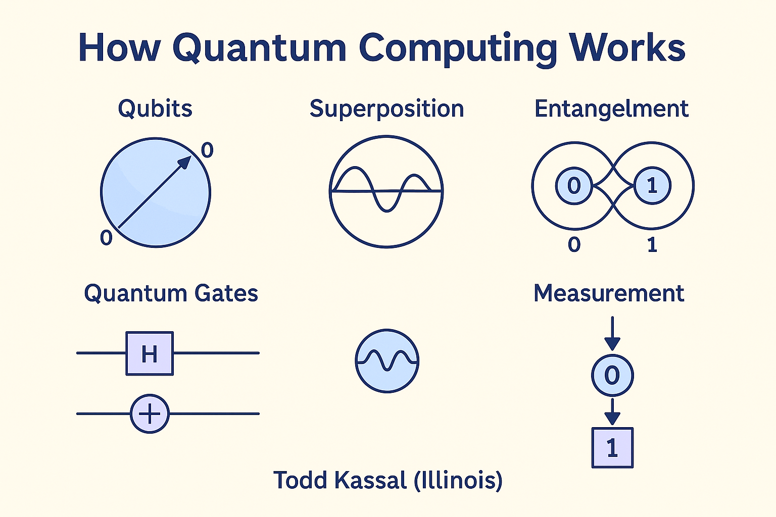

True Randomness Testing & Random Number Generators
NIST SP 800-22, Dieharder, VQR & QPP Projects A Comprehensive Overview of RNG Testing and Quantum Approaches

Slide 2



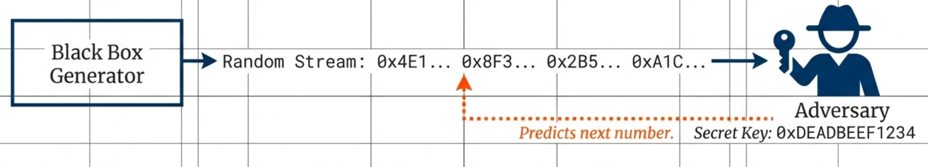
The Fundamental Problem
Can We Generate True Randomness?
Unpredictable ≠ Random
The term "Random Number Generator" is fundamentally a mathematical and computational oxymoron.
An event can be unpredictable due to insufficient data (entropy), but not necessarily truly random
Quantum Challenges
Even physical processes, including quantum experiments, present challenges in definitively proving true randomness versus unpredictability due to entropy or incomplete system knowledge
Proving Randomness
Distinguishing true randomness from unpredictability remains a fundamental challenge in computational systems and cryptography

Slide 3



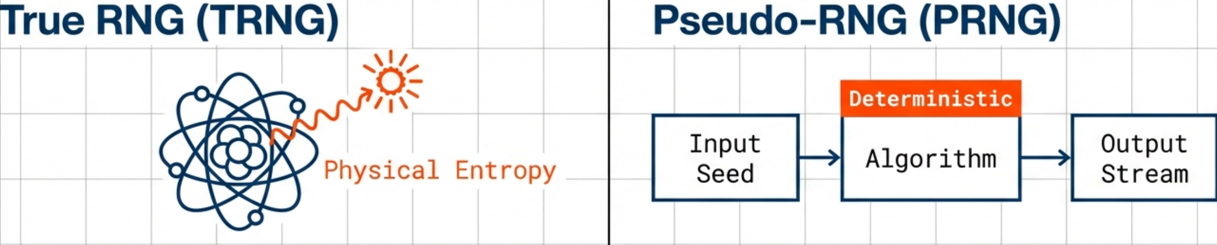
Types of Random Number Generators
Pseudorandom RNGs
True RNGs
Deterministic mathematical algorithms
Non-deterministic physical sources
Require random seed as input
Thermal noise, user input timing
Generate pseudorandom sequence
Quantum effects and processes
Seed must come from RNG outputs
Distillation process for quality
Efficient for large quantities
Must satisfy strict statistical criteria

Slide 4




Importance of Random Numbers
Monte Carlo Simulations
Cryptography
Sampling large phase spaces for complex system modeling
Fundamental basis of Internet commerce
Mathematics & Statistics
Games
Theoretical foundations and applied contexts
Ensuring unique and unbiased user experiences
"Random numbers are the sine qua non of modern computational systems and secure communications."

Slide 5

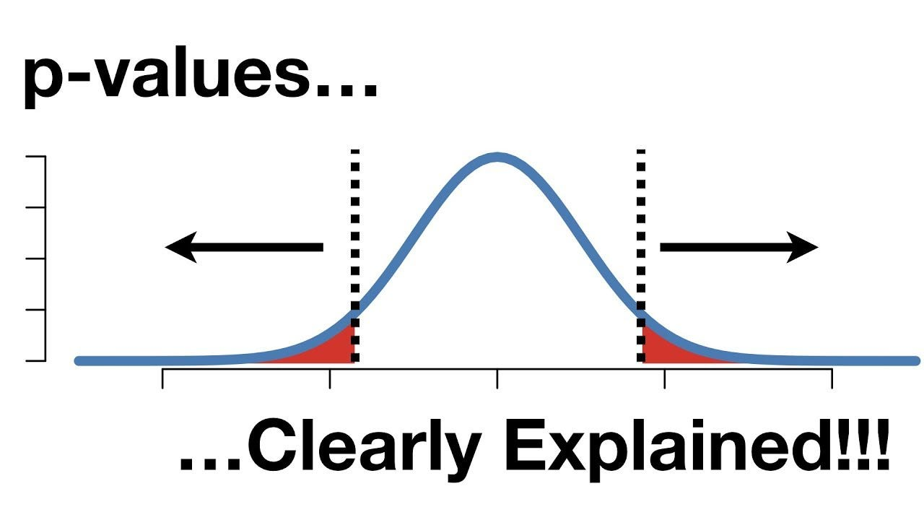



Statistical Testing Core Concepts
Purpose of Testing
Systematic test suite for all types of RNGs
Detect deviations from truly random sequences
Identify patterns or biases in binary sequences
Critical Goal
Minimize Type II errors — rejecting the null hypothesis when it's actually false
Test Framework
"Falsely accepting a sequence as good when the generator was actually bad."
Rigorous, systematic testing methodology
— NIST SP 800-22

Slide 6


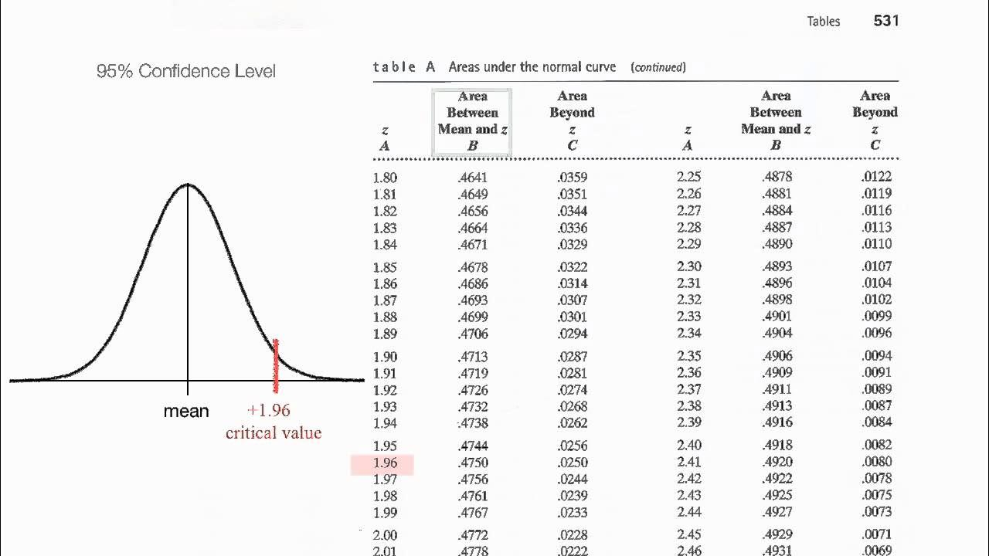



The Null Hypothesis & P-values
P-value Distribution
Null Hypothesis (H₀)
For good RNGs, P-values should be uniformly distributed across [0, 1)
The sequence being tested is random
Very Low P-value
< 10⁻⁶ → Reject H₀ (Bad generator)
High P-value
> 0.01 → Insufficient evidence to reject, but cannot prove H₀
Kolmogorov-Smirnov Test
"The null hypothesis can never be proven to be true, it can only fail to be observed to fail."
Evaluates uniformity of P-value distributions to determine probability of observing them in random sampling
— DieHarder

Slide 7







Key Test Suites - NIST SP 800-22
Purpose
Extend Diehard's methodology • Focus on bit-level randomness for cryptographic applications
Current Status
15 Tests
"Clearly Obsolete, Possibly Harmful"
• Frequency (Monobit)
• Runs Test
No longer used by NIST's DRBG validation
• Binary Matrix Rank
• DFT Transform
Weak PRNGs can pass, creating false confidence
• Universal Statistical
• Linear Complexity
• Serial Test
• Approximate Entropy
Purely statistical, not cryptographic security
• Cumulative Sums
• Random Excursions
Design Principles
Key Criticism
Unpredictability — Essential for crypto
FIPS 140-3 requires more robust SP 800-90A and SP 800-90B standards
Scalability — Tests apply to subsequences
Consistency — Across seeds

Slide 8



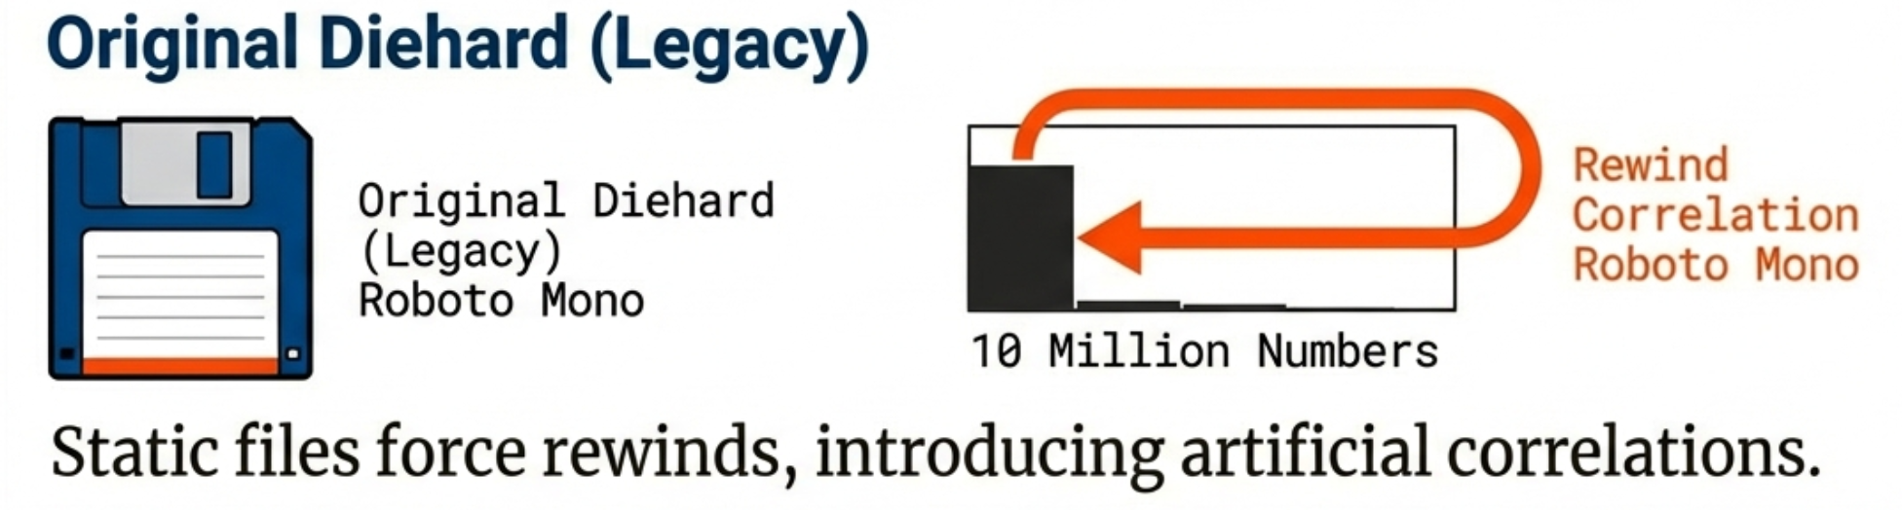
Key Test Suites - Diehard
Strengths
Weaknesses (Addressed by Dieharder)
Strong reputation for testing subtle non-randomness
Limited tests for bit-level randomness
From bit-sequence to uniform deviate distributions
Lack of parametric variability
Many tests lacked concluding KS test
Developed by George Marsaglia
Partially overlapping sequences (not truly independent)
Ambiguous licensing

Slide 9




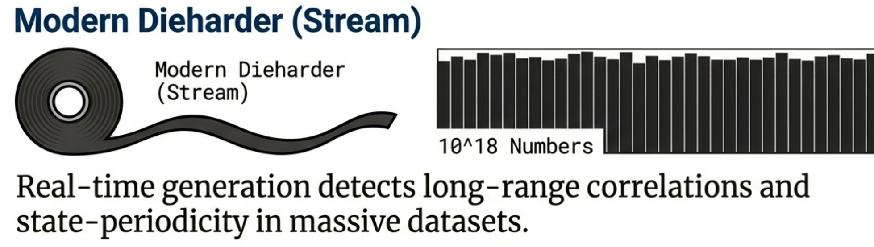
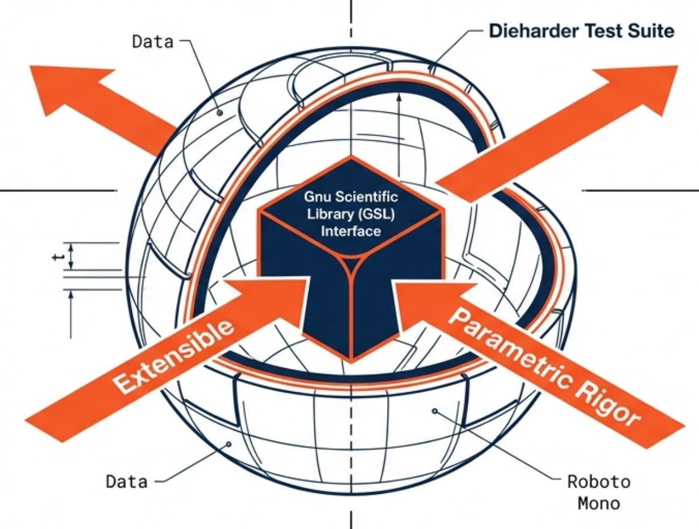
Key Test Suites - Dieharder
Key Features & Improvements
KS Test for All Tests
Adjustable Parameters
Motivation
Single P-value from KS test
Parametric exploration
Visual Histograms
Modular Structure
Address weaknesses of Diehard
P-value distributions
Easy to create/maintain tests
Extend RNG testing capabilities
Rewritten Code
GSL Integration
Provide comprehensive test framework
Well-commented C code
Gnu Scientific Library
Long Sequence Testing
Extensibility
Up to 10¹⁸ numbers
Incorporate all test suites
Timing Harness
Measure RNG speed

Slide 10















Examples of RNG Performance
mt19937
randu
slatec
Good Generator
Bad Generator
Ugly Generator
Fast
Fast
Speed
28×10⁷ rands/sec
39×10⁷ rands/sec
Similar to mt19937
Bit Persistence
Bit Persistence
Bit Depth
PASSED • No bits repeat
FAILED • 2 LSBs never change
Only 22 bits returned
Bit Distribution
Bit Distribution
Randomness
5-bit random, not 6-bit
Not even 1-bit random
Fails even 1-bit random
Diehard Tests
Results
Suitability
Most passed, some marginal
Cascading test failures
Unsuitable for any purpose

Slide 11







Modern Perspectives & Critiques
Critiques of Traditional Black-Box Testing (SP 800-22)
Outdated Foundation
False Confidence
Predates modern cryptography and information theory
Weak generators can pass, creating false confidence in insecure systems
Limited Focus
Incomplete Security
Focuses on statistical properties, not cryptographic security
Inadequate addressing of physical/interface security and backdoors
Missing Security Context
Modern Requirements Go Beyond Statistical Testing
Fails to consider computational hardness of breaking generators

Slide 12












Modern Security Requirements for Cryptographic RNGs
Evaluation Framework
Resistance to Attacks
Pseudorandom Generator Evaluation
Mathematical proofs linking DRBG to AES/SHA
Computational Indistinguishability
Forward/Backward Secrecy
Implementation Validation
Known Answer Tests (KATs) with formal methods
Entropy Source Evaluation
Stochastic modeling for expected entropy
No Backdoors/Trapdoors
Quantum Resistance
Physical/Interface Security
Robust protection from monitoring & interference
Modern Standards: SP 800-90 Series & AIS-31

Slide 13






Testing Frameworks and Datasets
Sample Test Results (mt19937)
Birthdays
Op Perm5
Testing Tools Overview
PASSED
PASSED
Rank 32x32
Rank 6x8
Dieharder
PASSED
PASSED
Extended methodology • KS test on all P-values
Bitstream
OPSO
PASSED
PASSED
ent (Entropy Testing)
OQSO
DNA
Entropy: 7.999994 bits/byte
PASSED
PASSED
Compression: 0%
Count 1s
Parking Lot
PASSED
PASSED
Chi-square: p ≈ 92.73%
Mean: 127.5 (ideal)
2D/3D Sphere
Squeeze
π estimate: error 0.04%
Correlation: 0.0 (ideal)
PASSED
PASSED
Sums
Runs
NIST SP 800-90B
PASSED
PASSED
Entropy source assessment tools
GCD
Craps
PASSED
WEAK
All Major Tests PASSED

Slide 14
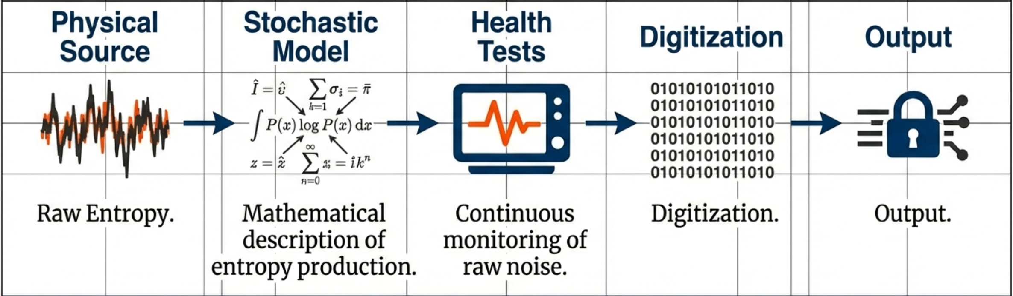
Strategy of RNG Testing

